Slide 1
Lesson 22
Oracle Cloud Overview

Slide 2

Lesson Objectives
After completing this lesson, you should be able to do the following:
  Describe the salient features of Oracle Cloud
  Discuss the features of Oracle Database Exadata Express Cloud Service

Slide 3

Lesson Agenda
  Overview of Oracle Cloud
  Working with Oracle Database Exadata Express Cloud Service

Slide 4

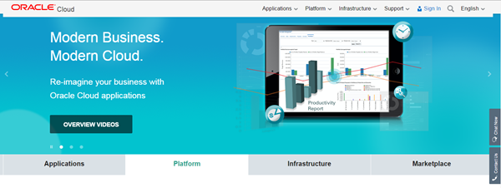




Introduction to Oracle Cloud
  Any business can now use the enterprise cloud provided by Oracle.
  You can access the Oracle Cloud from cloud.oracle.com.
Measured service
Resource pooling
Rapid elasticity
On-demand
self-service
Broad network
access

Slide 5


Oracle Cloud Services
Oracle Cloud provides three types of services:
  Software as a Service (SaaS)
  Platform as a Service (PaaS)
  Infrastructure as a Service (IaaS)

Slide 6










Cloud Deployment Models
Community cloud
Cloud Deployment Models
Public cloud
Private cloud
Hybrid cloud

Slide 7
Lesson Agenda
  Overview of Oracle Cloud
  Working with Oracle Database Exadata Express Cloud Service

Slide 8








Evolving from On-premises to Exadata Express
On-premises Database deployments
Cloud Database deployments

Slide 9
What is in Exadata Express?
  A fully managed database service
  Provides powerful yet elastic database cloud service for developers
  Provides on-demand access to a shared pool of database resources
  Comes with built-in tools for rapid application development
    APEX for web application development
    Compatibility with clients such as SQL Developer, SQLcl

Slide 10
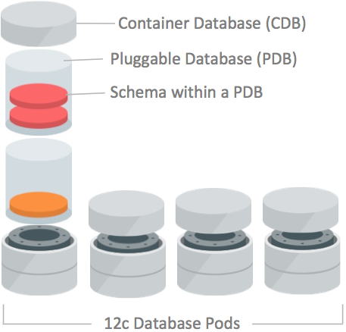
Exadata Express for Users
  Oracle manages the service as multiple Container databases(CDBs), also known as database pods
  Each CDB can accommodate upto 1000 Pluggable databases(PDBs).
  Each user is provisioned with a PDB on subscribing to the service, where the user can create several schemas.

Slide 11
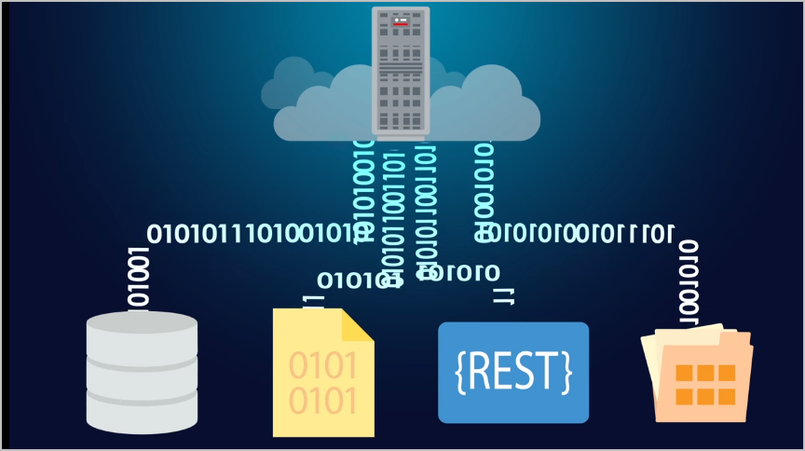
Exadata Express for Developers
  Developers can connect with a wide range of data sources for their applications
    JSON Document Storage
    Document Style data access
    Oracle Rest Data Services

Slide 12
Getting Started with Exadata Express
  Purchase a subscription.
  Activate and verify the service.
  Verify activation.
  Learn about users and roles.
  Create accounts for your users and assign them appropriate privileges and roles.
  Set the password for the database user authorized to perform administrative tasks for your service (PDB_ADMIN).
Note: You can refer to Using Oracle Database Exadata Express Cloud Service (https://docs.oracle.com/cloud/latest/exadataexpress-cloud/CSDBP/toc.htm) for details on the subscription process.

Slide 13
Oracle Exadata Express Cloud Service
You can refer to Working with Oracle Database Exadata Express Cloud Service (http://oukc.oracle.com/public/redir.html?type=player&offid=1984115860) to gain an introduction to the service and its features.

Slide 14
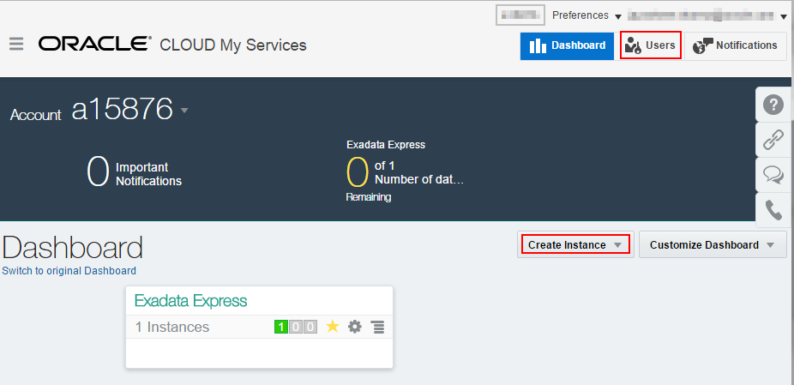
Getting Started with Exadata Express
  On signing into the service, you get access to the dashboard.
  Dashboard allows you to create database instances and users.
  The number of instances you create is limited by the amount of resources you have access to.

Slide 15
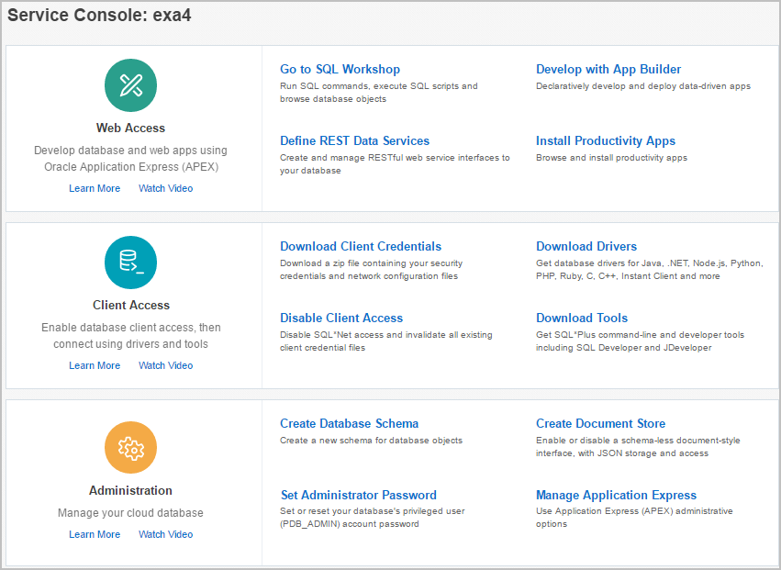
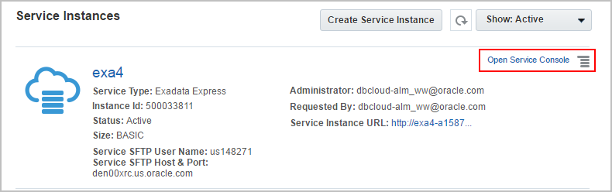
Managing Exadata

Slide 16
Service Console
  Service Console is the interface to use and manage the Exadata service
  It provides three different perspectives of the instance
    Web Access
    Client Access
    Administration

Slide 17
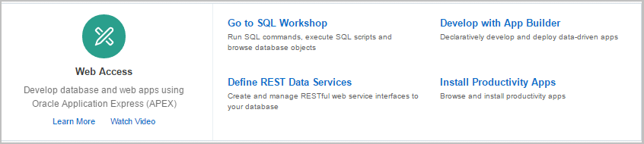
Web Access through Service Console
For quick development of applications
To execute SQL and PL/SQL
To define RESTful services on the database
Reuse apps from pre-built APEX applications

Slide 18
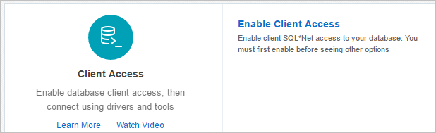
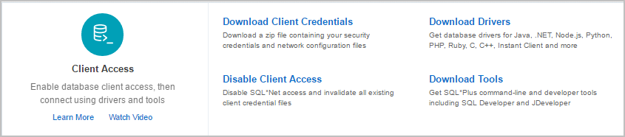
Client Access Configuration through Service Console

Slide 19
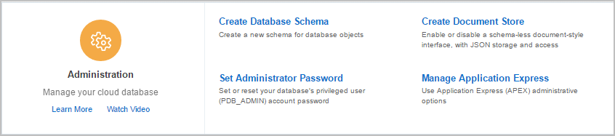
Database Administration through Service Console
Create a new schema for database objects
To create a document store using a schema
Set or reset password for admin
To manage tasks such as archiving APEX schemas and association among APEX schema

Slide 20
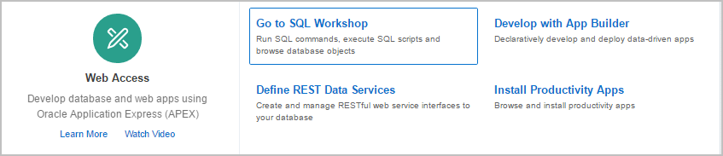

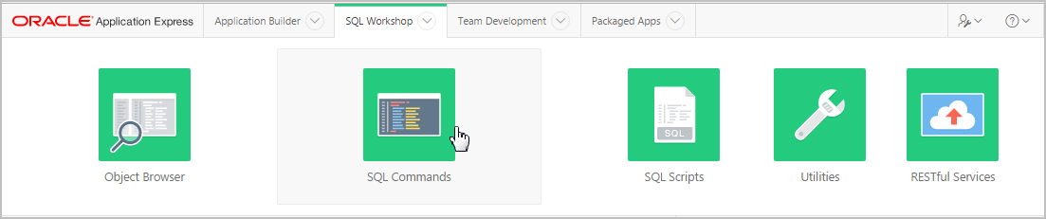
SQL Workshop
1
Clicking on SQL workshop will lead you to APEX interface
2
To run SQL or PL/SQL you can use the SQL commands utility

Slide 21
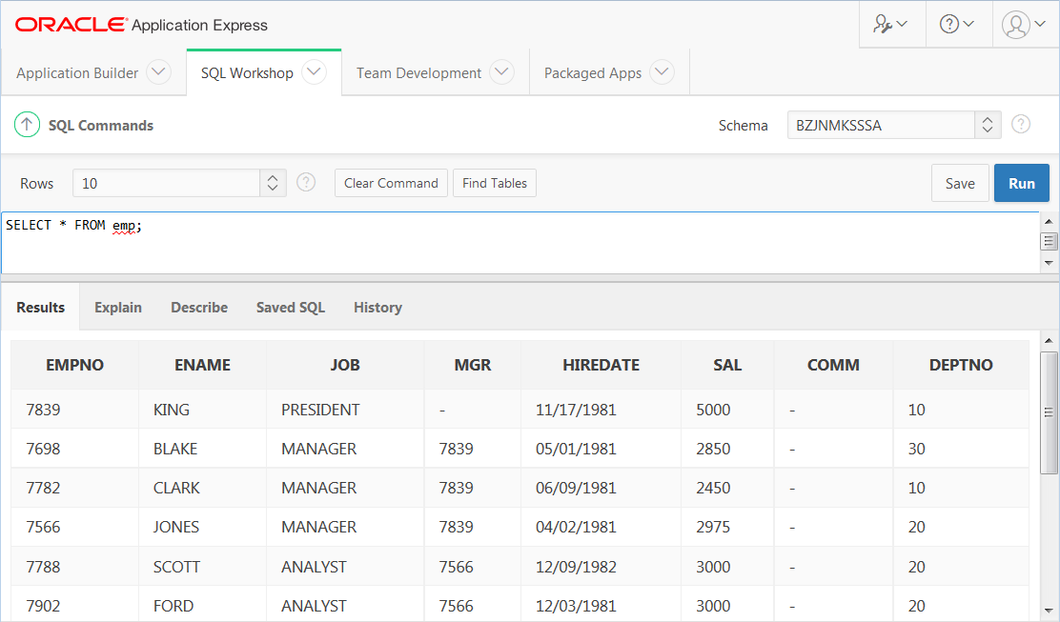
SQL Workshop
You can run SQL statements in the editor.
2
Value
Unique key column
Unique key column
Unique key column
Unique key column

Slide 22
Connecting through Database Clients
You can connect to Exadata Express through various database clients.
Some of the database clients include:
  SQL*Plus
  SQLcl
  SQL Developer
  .Net and Visual Studio
  JDBC Thin Client

Slide 23
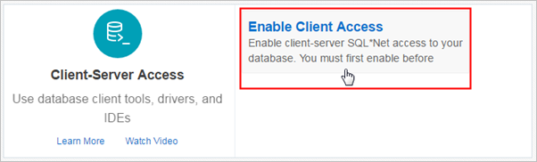
Enabling SQL*Net Access for Client Applications
Enable SQL*Net Access in the Service Console to obtain the various Database Client options.

Slide 24
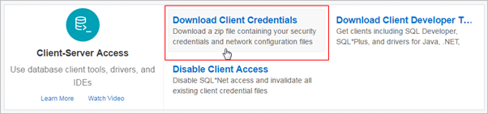
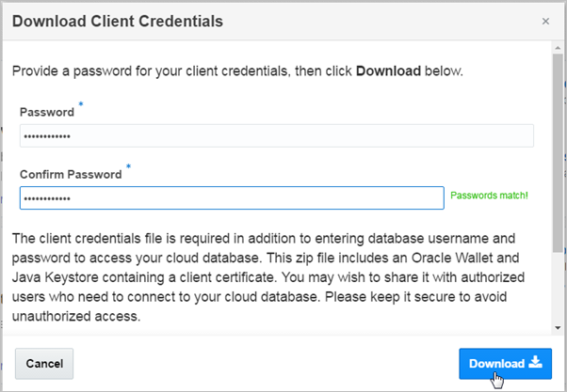
Downloading Client Credentials

Slide 25
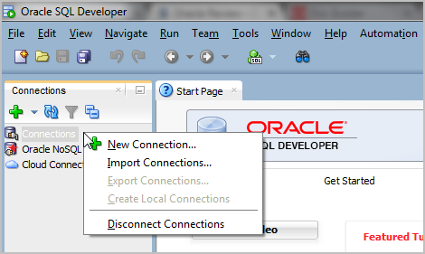
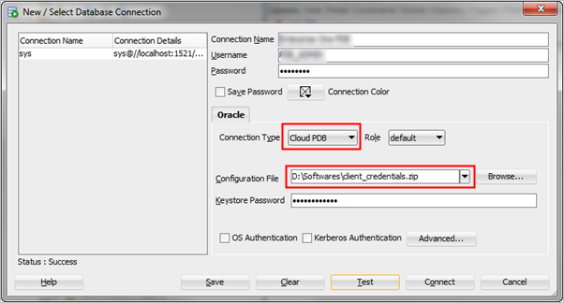
Connecting Oracle SQL Developer
1
Cloud PDB in indicates that connection is made to Exadata Express
2
Keystore Password is the password entered while downloading the client credentials.

Slide 26




Connecting Oracle SQLcl
D:\PDB Service\SQL CL\sqlcl-no-jre-latest\sqlcl\bin>sql /nolog
SQLcl: Release 4.2.0.16.160.2007 RC on Thu Sep 08 12:18:07 2016
Copyright (c) 1982, 2016, Oracle. All rights reserved.
SQL>
1
SQL> set cloudconfig client_credentials.zip
Wallet Password: ************
Using temp directory:C:\Users\APOTHU~1.ORA\AppData\Local\Temp\
oracle_cloud_config6707346342028726502
2
SQL> conn pdb_admin/welcome1@dbaccess
Connected.
SQL>
3

Slide 27

Summary
In this lesson, you should have learned about:
  The salient features of Oracle Cloud
  Oracle Database Exadata Express Cloud Service

